Slide 1
FRW Back-Office Officer Training
Friends Recruitment World

Slide 2
FRW Back-Office — Officer Training Manual

Slide 3
Version: 1.0
Date: 2026-05-16
Audience: office staff, finance officers, sub-broker agents, vendor agents, worker self-service users
Prerequisite: valid login at https://www.frwjobs.com/[locale]/login. Locale = en or bn.

Slide 4
Table of Contents
System overview & roles
Worker lifecycle — end-to-end flow
Login + navigation basics
Dashboard
Agents module
Passenger module
Ticket module
Services module — stage editors
Reports module
BMET module
Forms module — printable
Admin — Agency Settings
Finance portal
Agent portal
Worker (Passenger) portal
Scraped Circulars (Amiprobashi)
Day/Night mode, language switch, print
Common errors & fixes
Checklists — quick reference

Slide 5
1. System overview & roles
Role | Login URL | Portal | Can do
ADMIN / HR / RECRUITER (office staff) | /[locale]/login | /admin/ops | Full back-office: passengers, agents, demands, tickets, BMET, forms, reports
FINANCE | /[locale]/login | /finance | Chart of accounts, vouchers, invoices, vendor bills, payroll, reports. Cannot edit passenger stage data
PASSENGER_AGENT (sub-broker) | /[locale]/login | /agent | Own passengers only; demand circulars; commission view; complaints
SERVICE_AGENT (vendor: medical, visa agent, TTC, ticketing agency) | /[locale]/login | /agent | Own assigned passengers; service-specific stage edits only
WORKER (passenger) | /[locale]/login | /passenger | Own status, document list, flight info, pay outstanding fees, file complaint
The FRW back-office is a single web application that runs all overseas-recruitment operations: agent management, worker pipeline (medical → visa → training → manpower → flight), tickets, complaints, BMET filings, payments, and double-entry finance.
Role matrix

Slide 6
Each transition is recorded in PassengerStatusEvent (audit log). The Placement’s currentStage advances automatically when a stage editor is saved. Dashboard KPIs read from this.
Role is set at user creation by admin. To create a user, use the existing user-management UI or the Prisma seed scripts.
Stage map — the pipeline
Diagram 1

Slide 7
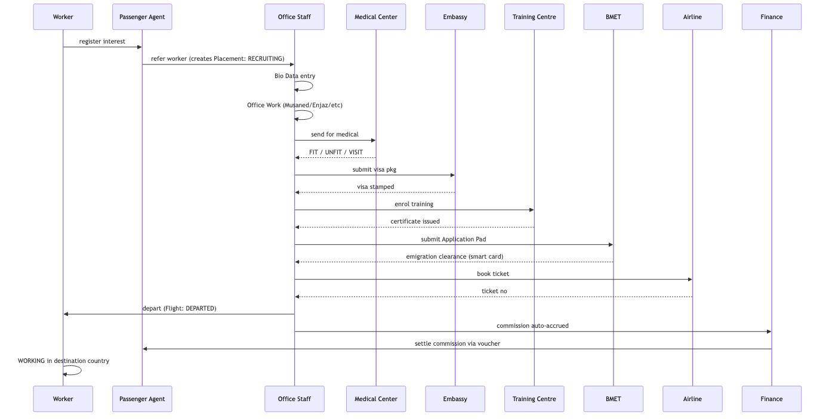
2. Worker lifecycle — end-to-end flow
Diagram 2

Slide 8
3. Login + navigation basics
Element | Where | Purpose
Left side nav | every back-office page | Module groups: Agents / Passenger / Ticket / Services / Reports / BMET / Forms / Admin
Top bar — title + global search | every page | Search by Job ID, PR No, Passport, or Name
Theme toggle | top right (sun/moon icon) | Day = warm cream; Night = slate-blue. Persists per device.
Locale switcher | top right | EN ⇄ BN ⇄ AR. The whole UI re-renders.
Open https://www.frwjobs.com/en/login (or /bn/login for Bangla).
Enter email + password supplied by admin.
After login the system routes you by role:
  office staff → /en/admin/ops
  finance → /en/finance
  sub-broker / vendor → /en/agent
  worker → /en/passenger
Common UI elements (back-office)

Slide 9
Keyboard shortcuts
Ctrl/Cmd + P — print the current page (forms render to PDF cleanly).
Type into the global search → press Enter → opens passenger detail.

Slide 10
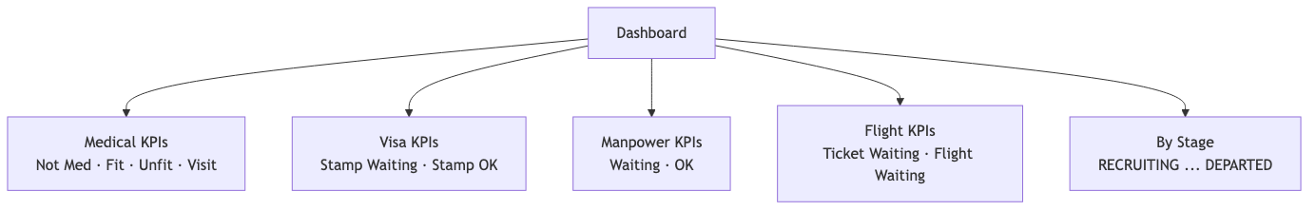
4. Dashboard
How to read: - Tones — red = blocked, amber = waiting, green = good. - Click no actions on cards (read-only summary). Drill in via side-nav modules.
URL: /[locale]/admin/ops
Four KPI cards + a Passengers-by-Stage breakdown. Counts are live — refresh page to update.
Diagram 3

Slide 11
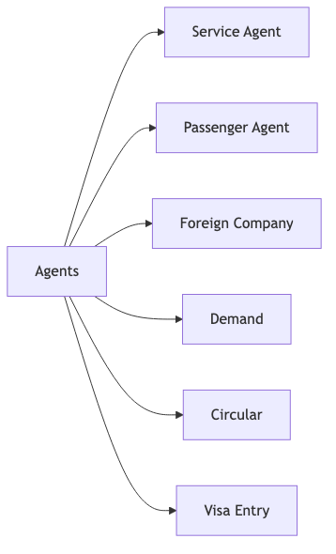
5. Agents module
5.1 Service Agent
Purpose: vendors who provide a service — medical centre, visa-stamping agent, TTC, ticketing agency.
Fields: group, name, NID, gender, parents, address, country, district, contact, emergency contact.
Workflow: 1. Click + Add New. 2. Fill all fields (NID + contact mandatory for KYC). 3. Save → row appears in list. 4. Edit via pencil icon. Status toggle ACTIVE/INACTIVE only — never delete (FK to Placement.visa.serviceAgent).
5.2 Passenger Agent
Purpose: sub-broker who refers workers. Earns commission per departure.
Fields: agent code (unique — used for login), agent group, name, NID, image, parents, address, contact, emergency, optional User link (for portal login).
Workflow: 1. + Add New → fill, upload image. 2. To grant portal login: create a User with role PASSENGER_AGENT and assign userId. Login URL: /[locale]/login.
5.3 Foreign Company
Purpose: employer abroad (Saudi co, Kuwaiti co, etc).
Fields: name, country, stamp image, signature image, agreement docs (multi-file).
5.4 Demand
Purpose: job order from a foreign company. Drives the Circular and what positions can be filled.
Fields: foreign company, visa agent, country, category, quantity, salary, purchase rate, office rate, status (ACTIVE/CLOSED), notes.
Why office rate matters: auto-commission on departure is calculated as 5% of officeRate. Set it correctly.
5.5 Circular
Purpose: printable list of all ACTIVE demands. Display only — no edit.
Click “Print” to generate a printable A4 sheet.
5.6 Visa Entry
Purpose: quick-edit visa data per passenger, filtered to those not yet DEPARTED.
Diagram 4

Slide 12
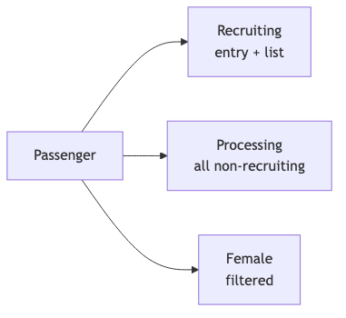
6. Passenger module
6.1 Recruiting
Where new workers are added. First step for every passenger.
Mandatory: Job ID (auto-generated FRW-YYMMDD-NNN), PR No, name, gender, contact, target country, passenger agent.
After save → passenger appears at currentStage = RECRUITING. Now appears in global search and in Processing list once you start editing stages.
6.2 Processing
All passengers with currentStage ≠ RECRUITING, DEPARTED, CANCELLED, RETURNED, ON_DUTY. The day-to-day work queue.
6.3 Female
Same as Processing but filtered to gender = FEMALE. Some destinations (KSA HSW visa) have female-specific paperwork.
Diagram 5

Slide 13
7. Ticket module
Sub-page | Use
Purchase & Sales | new ticket sale entry
Refund | mark sold ticket refunded — auto-posts to finance
Sales Report | revenue by date / agency
Search | by ticket no, passport, PNR
Posting | bulk post to finance
Edit | correct ticket data
Entry | similar to Purchase & Sales — alternative form
Entry Report | summary of entries
Separate from passenger Flight stage. Handles walk-in airline-ticket sales.

Slide 14
Refund flow:
Diagram 6

Slide 15
8. Services module — stage editors
8.1 Bio Data (Male) / (Female)
Male: post, height/weight, qualification, experience, languages, photo.
Female: place of birth, residence, #children, education, Arabic/English skill, complexion, country, experience task, remarks.
Saves to BioDataMale / BioDataFemale (1:1 with Placement).
8.2 Office Work
Musaned reg, Enjaz reg, certificate, Enjaz payment, company interview, approval, agreement, driving licence, BMET interview, selection, Mohakama file.
8.3 Medical (Slip + Entry)
Slip — printable slip with photo + barcode for the medical centre.
Entry — record results: centre, slip no, status (FIT / UNFIT / NOT_MED / VISIT), MOFA number/date, calling date, exam date, expiry, current status, attach receipt + certificate files.
UNFIT → Placement is marked CANCELLED via Multiple Status Update.
8.4 Embassy (= Visa)
Visa no, sponsor (Arabic + English), profession (Arabic + English), MOFA no, stamping date, certificate expiry, finger status, police clearance, Musaned no, delivery date, ministry permission, status (STAMP_WAITING / STAMP_OK / REJECTED).
8.5 Training
Admission date, roll no, certificate no, serial, recruiting agency, certificate date, status, batch number, TTC name, training card Y/N, current status, certificate file.
8.6 Manpower (BMET smart card)
Finger Y/N + date, visa issue date, bank account no, bank name, visa expire date, manpower date, registration ID, status (WAITING / OK), smart card file, delivery date.
8.7 Flight
Carrier, issue date, flight date, flight time, arrived time, flight no, ticket no, ticketing agency, country, sector, status (TICKET_WAITING / FLIGHT_WAITING / DEPARTED / CANCELLED), ticket copy file, no-ticket flag.
When status = DEPARTED is saved: the system automatically: 1. Sets Placement.currentStage = DEPARTED, departureDate = now. 2. Creates an AgentCommission row (5% of demand officeRate). 3. Posts a Journal Voucher: Dr Commission Expense, Cr Payable (to that PassengerAgent).
This is idempotent — saving DEPARTED twice does not double-accrue.
8.8 Multiple Status Update
Select multiple passengers, change one stage’s status at once. Use for bulk Medical → FIT after a batch result, or Flight → DEPARTED for a group on the same plane.
8.9 Foreign Company Signature
Upload the FC’s signature/stamp image. Reused in printed visa forms.
These are the per-passenger editors. Each writes a row in the matching table AND advances the Placement’s currentStage AND logs to PassengerStatusEvent.
Diagram 7

Slide 16
9. Reports module
Report | Shows
Medical | passengers with medical stage data; filter by status
Visa | visa stage data; sponsor / MOFA / stamping summaries
Finger | finger registration roll
Manpower | BMET smart card status
Training | TTC enrolment + completion
Flight | departures and pending tickets
Passenger Status Summary | counts per stage per country
Passenger List | full export incl. non-return-PP flag
Visa Entry Reprint | reprint visa entry slip
Passenger Agent List | sub-broker directory
Service Agent List | vendor directory
Make A List | column-picker: choose any subset of passenger fields, save as named report
All reports support date-range, country, gender, agent, status filters and CSV export.

Slide 17
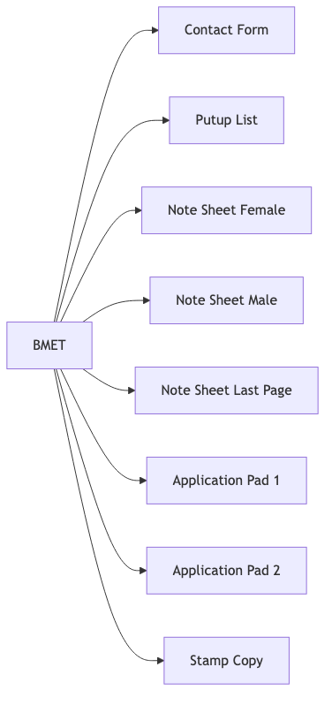
10. BMET module
10.1 Contact Form
Employment contract between FRW and worker — bilingual (Bangla + English). Auto-fills from Placement + Visa.
10.2 Putup List
Daily processing log. List of passengers being submitted to BMET that day.
10.3 Note Sheet (Male / Female / Last Page)
Tracks per-batch callan fees, smart card fees, aikor chalan fees, bank routing, pre-order dates. Maintained chronologically.
10.4 Application Pad 1 / 2
Pad 1 — BMET clearance application + attachment list (stamp, passport copy, pay order, training cert, putup, medical, contract, smart card form).
Pad 2 — additional attachments + final approval request.
Both render in Bangla + English. Header pulls RL no + address from Agency Settings.
10.5 Stamp Copy
Reprint of the BMET-stamped pages for archive.
Diagram 8

Slide 18
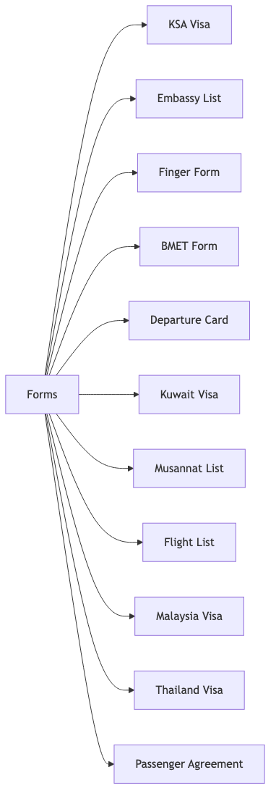
11. Forms module — printable
All forms render in bilingual layout. Search by Job ID at the top, then Print.
Diagram 9

Slide 19
Form | Languages
KSA Visa | Arabic + English
Kuwait Visa | Arabic + English
Malaysia Visa | Bahasa + English
Thailand Visa | Thai + English
Departure Card | Bangla + English
Passenger Agreement | Bangla (primary) + English summary, 2 pages, thumb-print
BMET Form / Application Pad | Bangla + English
Others (Embassy List, Musannat List, Flight List, Finger Form, Stamp Copy) | English

Slide 20
Each visa form has: Personal · Passport · Visa & Sponsor · Medical & Training · Contact · Declaration · Signature + Thumb + Agency Stamp.
Print tips: - Print preview at 100% scale. - Forms force pure white + black under @media print regardless of day/night theme. - Photo box and thumb box render empty for manual paste — embedded photo uploads will land in P-7 upgrade.

Slide 21
12. Admin — Agency Settings
URL: /[locale]/admin/ops/settings
Fields: - RL No — BMET recruiting-agent licence number. Appears on every form header. - Office Address — full address. - Hotline — public phone. - BMET Code — optional. - Owner / Authorised Signatory — appears under signature blocks.
Stored in DB (AppSetting table). Cache TTL = 30 sec. Reprint any form to see the change.
Important: set these BEFORE printing real forms. Default RL-XXXX is a placeholder.

Slide 22
13. Finance portal
13.1 Chart of Accounts
5 types: Asset, Liability, Equity, Income, Expense. Add a code + name + parent + tax flag. Required accounts: - ASSET: Cash on Hand, Bank — Main, SSLCommerz Receivable, Accounts Receivable - LIABILITY: Accounts Payable - INCOME: Recruitment Fee, Ticket Sales - EXPENSE: Vendor Cost, Agent Commission, Salary, Office Rent, VAT
Auto-journal looks up accounts by name keyword — keep names recognisable.
13.2 Vouchers
Every voucher = balanced double-entry. The system rejects unbalanced vouchers.
URL: /[locale]/finance. Role FINANCE required.
Diagram 10

Slide 23
Voucher type | When used | Example posting
Payment Voucher (PV) | money out | Dr Vendor Cost, Cr Bank
Receipt Voucher (RV) | money in | Dr Bank, Cr AR
Journal Voucher (JV) | accrual / adjustment | Dr Commission Expense, Cr AP
Contra Voucher (CV) | Bank ⇄ Cash transfer | Dr Cash, Cr Bank

Slide 24
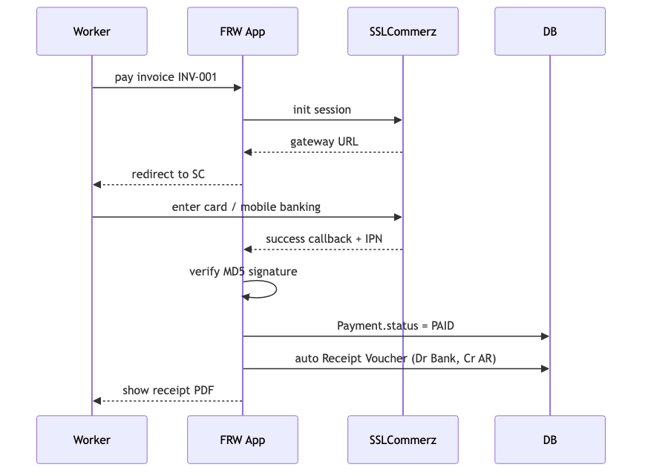
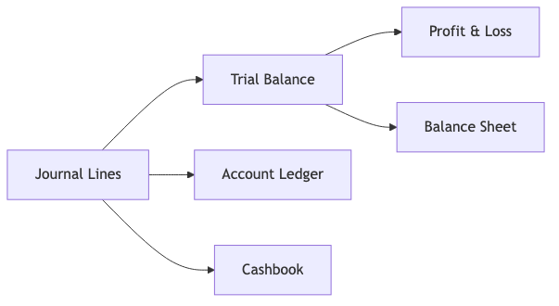
Trial Balance — always equal. Mismatch = bug.
P&L — income − expense for selected period.
Balance Sheet — Asset = Liability + Equity.
13.8 Fiscal Period
Close the month/year → no further entries with date in that range.
13.9 Payments (gateway)
Two paths: 1. SSLCommerz (online): worker pays via /passenger/billing → SSLCommerz → IPN webhook fires → Payment row PAID → Receipt Voucher auto-posted. 2. Bank transfer (manual): operator marks invoice paid → attaches deposit slip → same Receipt Voucher.
Voucher number auto-generates PV-YYYY-NNNN etc.
13.3 Invoices
Issued to: candidate (placement fee) or employer (recruitment fee). Generates from passenger record. Auto-posts: Dr AR, Cr Recruitment Fee.
13.4 Vendor Bills
Vendors: medical centre, visa agent, TTC, ticketing agency, sub-broker (commission settlement).
Auto-posts: Dr Vendor Cost, Cr AP.
13.5 Agent Commissions
Accrued automatically on passenger DEPARTED. Settle via Payment Voucher → marks isSettled = true.
13.6 Payroll
Staff salary entry → generates payslip → posts: Dr Salary Expense, Cr Bank.
13.7 Reports
Diagram 11
Diagram 12

Slide 25
14. Agent portal
URL: /[locale]/agent
Sub-broker (Passenger Agent) sees: - Own passengers only — scope enforced by agentScope.ts. - Demand circulars (read-only). - Commission ledger — accrued + settled. - File complaint on behalf of own passenger.
Service Agent (vendor) sees: - Passengers assigned to them (via Visa.serviceAgentId, Medical etc). - Service-specific stage editor (e.g. medical centre can edit Medical fields only).

Slide 26
15. Worker (Passenger) portal
URL: /[locale]/passenger
The worker logs in to see: - Own pipeline status (current stage, history events). - Document list (uploaded passport, visa, medical certificate, BMET card). - Flight details (date, time, airline, sector, ticket). - Outstanding fees + Pay Now button (SSLCommerz). - Payment history + receipt download. - File complaint.

Slide 27
16. Scraped Circulars (Amiprobashi)
URL: /[locale]/admin/ops/scraped-circulars
Weekly scrape of MoEWOE Amiprobashi portal. Each row has: - Hide / Takedown buttons (instant removal). - Promote to Job button (creates a public Job with source = BD_SCRAPE, full attribution, deep-link to original). - “Source: amiprobashi.com — Govt of Bangladesh” badge on every promoted job.
Scraped jobs are excluded from sitemap (avoid competing with original).

Slide 28
17. Day/Night mode, language switch, print
Theme
Click sun/moon icon top-right.
Day = warm-cream page (#faf7f1), softer borders, easy on eyes for long sessions.
Night = slate-blue (#0b1220), bright text.
Persists in localStorage.frw.theme. Anti-flash inline script sets the class before React hydrates.
Print always uses pure white + black regardless of theme (the @media print block forces it).
Language
Switch via top-right locale dropdown: EN / BN / AR (and 3 more public-facing langs).
The whole UI re-renders. URL changes to /bn/....
Back-office uses EN + BN keys; missing keys fall back to EN.
Print
Ctrl/Cmd + P from any form page.
Forms render under PrintableShell — A4 max width, FRW header (RL no + address from Agency Settings), footer with copyright.
Set browser margins to “Default” or “None” for best fit.

Slide 29
18. Common errors & fixes
Error / message | What it means | Fix
“No passenger found for X” on a form | Job ID typo or wrong ref | Use global search to find correct Job ID, then re-enter
“INVALID_INPUT” on save | Missing required field | Check red-highlighted fields; refer to schema in this manual
“UNAUTHORIZED” | Logged out / wrong role | Re-login. Verify your role with admin
“Voucher unbalanced” in Finance | Debit ≠ Credit | Recount lines
Form header still says RL-XXXX | Settings not configured | Go to /admin/ops/settings, fill RL No, save
Print preview shows side nav | Print stylesheet not applied | Use Ctrl/Cmd + P, not screenshot. Hard-refresh if stale
Bangla shows as boxes on print | Nikosh font not loaded | Wait for page load to complete before print; check network

Slide 30
19. Checklists — quick reference
Onboarding a new worker (golden path)
☐ Recruiting entry — Job ID, PR No, name, contact, country, passenger agent
☐ Bio Data (M or F) — full personal info, photo
☐ Office Work — Musaned reg, employer interview, agreement
☐ Medical Slip — print, send to GAMCA centre
☐ Medical entry — status FIT/UNFIT/VISIT
☐ If FIT → Embassy/Visa entry — sponsor, profession, MOFA no, stamping date
☐ Training — enrol TTC, certificate
☐ Application Pad 1 + 2 — print, submit to BMET
☐ Manpower entry — finger + smart card details, status OK
☐ Ticket purchase + Flight entry
☐ Departure Card + Passenger Agreement — print + sign
☐ Flight status → DEPARTED (auto-accrues commission)
☐ Issue invoice + collect remaining fee (Finance)
Closing a finance period
☐ All pending vouchers entered for the period
☐ All vendor bills paid or accrued
☐ All agent commissions accrued (Departed rows)
☐ Run Trial Balance — verify Dr = Cr
☐ Run P&L + Balance Sheet — review
☐ Fiscal Periods → Close month
Filing a BMET batch
☐ Putup List printed
☐ All passengers Medical FIT + Visa stamped + Training certified
☐ Application Pad 1 + 2 printed per passenger
☐ Note Sheet entry (callan, smart card, aikor fees, bank routing)
☐ Submit to BMET, get receipt → store in Stamp Copy archive
Refunding a ticket
☐ Find ticket via /admin/ops/tickets/search
☐ Open ticket → Refund button
☐ Enter customer refund amount + airline retention amount
☐ Save → auto-posts journal: Dr Sales, Cr Bank for customer refund
☐ Hand cash / bank transfer to customer
☐ Mark refund slip signed by customer → attach to ticket

Slide 31
Appendix A — Status reference
Stage | Statuses (values stored in DB)
Placement.currentStage | RECRUITING, PROCESSING, BIO_DATA, OFFICE_WORK, MEDICAL, VISA, TRAINING, MANPOWER, FLIGHT, DEPARTED, ON_DUTY, RETURNED, CANCELLED
Medical.status | NOT_MED, FIT, UNFIT, VISIT
Visa.status | NOT_PROCESSED, IN_PROCESS, STAMP_WAITING, STAMP_OK, REJECTED
Training.status | NOT_STARTED, ENROLLED, COMPLETED, CANCELLED
Manpower.status | WAITING, OK, CANCELLED
FlightDetail.status | TICKET_WAITING, FLIGHT_WAITING, DEPARTED, CANCELLED
Complaint.status | NEW, IN_PROGRESS, RESOLVED, CLOSED
TicketSale.status | ISSUED, FLOWN, REFUNDED, CANCELLED

Slide 32
Appendix B — Audit trail
Field | Value
placementId | passenger ref
stage | BIO_DATA / OFFICE_WORK / MEDICAL / …
status | the new status value
userId | who saved it
occurredAt | timestamp
note | “ saved”
Every stage save writes a PassengerStatusEvent:

Slide 33
Used for: dashboard KPIs, passenger detail timeline, Status Summary report, complaint investigations.

Slide 34
Appendix C — Help
Tech issues: farhadh.35@gmail.com
Public site issues: see footer of https://www.frwjobs.com
BMET reference: https://www.bmet.gov.bd
Amiprobashi source: https://moewoe.amiprobashi.com (read-only, attribution required)

Slide 35
End of training manual. Print this document and keep at every workstation.

